Slide 1
Control and Optimization of Smart Grid
Steven Low
Computing + Math Sciences
Electrical Engineering
March 2015
Cornell Ithaca
Notes:
Caltech power system research:
Network architecture
June 2012: Caltech IST Advisory Board Meeting, Palo Alto (Mathieu Desbrun)
Oct 2012: GridWise Council Meeting (Paul, DeMartini, Ron Meltzer)
Dec 2012: Workshop on smart grid, University of Florida, Gainsville, FL (Sean Meyn)
Dec 2012: SCE Tech Advisory Board meeting, Westminster, CA
Dec 2012: Resnick Grid 2020 Seminar Panel, Caltech (Paul, DeMartini)
March 2013: Resnick Advisory Council, Caltech
April 2013: BCG, San Francisco, CA
May 21, 2013: Honeywell visit, Caltech (Rhonda Germany – Vice President, Chief Strategy & Marketing Officer, and team)
June 4, 2013: Electric Power Control Centers (EPCC) Workshop (Dejan Sobajic <dsobajic@gridengineering.com>)
June 25, 2013: FERC Technical Conference on Increasing Real-Time and Day-Ahead Market Efficiency through Improved Software (Richard O’Neill)
Branch Flow Model: relaxations, convexification, computation
May 24, 2012: Optimization and Control for Smart Grids, 32nd CNLS Annual Conference, Santa Fe, NM (Misha Chertkov)
June 11, 2012: Greenmetrics Workshop, London, UK (Adam Wierman)
June 26, 2012: FERC Conference, Washington D.C. (Dick O’Neil)
July 31, 2012: Energy Day, Chinese University of Hong Kong (Minghua Chen)
Aug 2, 2012: HK University of Science & Technology (Vince Lau, Roger)
Aug 3, 2012: Hong Kong University, EE Dept, HK (Victor Li)
Aug 6, 2012: Tsinghua University, Institute of Theoretical Computer Science, Beijing, China (Raymond Yeung)
Aug 17, 2012: Zhejiang University, EE Dept, Hang Zhou, China (Jiming Chen)
Aug 20, 2012: Shanghai Jiaotong University, EE Dept, Shanghai, China (Xinbing Wang)
Sept 5, 2012: U Texas A&M, Dept of ECE, Fishbowl Seminar Series (Srinivas Shakkottai)
Sept 2012: Swinburne University, Australia (Lachlan Andrew)
Nov 15, 2012: Distinguished Speaker, Northeast University, Boston MA (Edmund Yeh)
Equivalence of Branch Flow and Bus Injection Models
Oct 5, 2012: 50th Annual Allerton Conference (Dominguez-Garcia, Alejandro)
Exact relaxation for radial networks
Nov 6, 2012: IEEE SmartGridComm Conference (Tainan, Taiwan)
Jan 25, 2013: SUNY Buffalo, EE Dept (Dimitri Pados)
Feb 20, 2013: DIMACS workshop, Rutgers University, NJ (Dan Bienstock, SL)
March 20, 2013: UCLA SMERC Lecture (Rajit Gadh)
March 21, 2013: Systems and optimization aspects of smart grid challenges 2013, U Arizona, Tucson
March 28, 2013: Michigan, Ann Arbor (Ian Hiskens)
June 5, 2013: Electric Power Control Center (EPCC) Workshop (Dejan Sobajic, NYISO)
June 19, 2013: ACC Smart Grid Tutorial (Dennice Gayme, Ufuk Topcu)
July 4, 2013: 2nd International Workshop on Mathematical Issues in Information Sciences, Xi’an, China (Tom Luo)
August 25-30, 2013: IREP Symposium-Bulk Power System Dynamics and Control -IX (IREP), Rethymnon, Greece
Smart grid and OPF
Sept 26, 2013: Science & Technology Innovators Lecture Series, DTC, U of Minnesota, Minneapolis, MN (Giannakis)
November 29, 2013: University of Waterloo, Canadan (S. Keshav)
Feb 12, 2014: University of Washington, Seattle (Daniel Kerschen)
March 25-28, 2014: Short course, Zhejiang University [with Vincent Lau, HKUST] (Jiming Chen, Prof Zhang)
Tutorial: Convex relaxation of OPF
April 23, 2014: RTE-IBM workshop on “Semidefinite Programming for Optimal Power Flow Problems”, Dublin, Ireland (Patrick Panciatici, RTE)
June 19-23, 2014: Lehigh University, PA (Nader Motee)
August 20, 2014: PSCC invited session, Wroclaw, Poland (Patrick Panciatici)
Oct 15, 2014: LCCC Workshop on Dynamics and Control in Networks, Lund, Sweden (Anders Rantzer)
Oct 27, 2014: IEEE Trans on Control of Network Systems Symposium, Boston (Yannis Paschilidis)
High-level Smart Grid Research
Feb 2015: Caltech Lunch Bunch
Mar 16, 2015: Workshop: Information and Communication Systems and their application to vertical sectors (Fernando Paganini, Daniel Kofman)
March 18, 2015: Cornell NYCTech (Dan Huttenlocher)
March 20, 2015: Cornell Ithaca (Lang Tong)

Slide 2




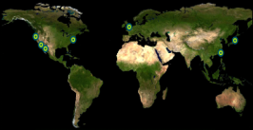

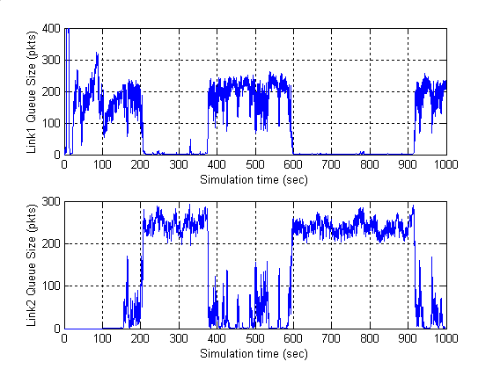
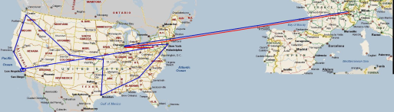




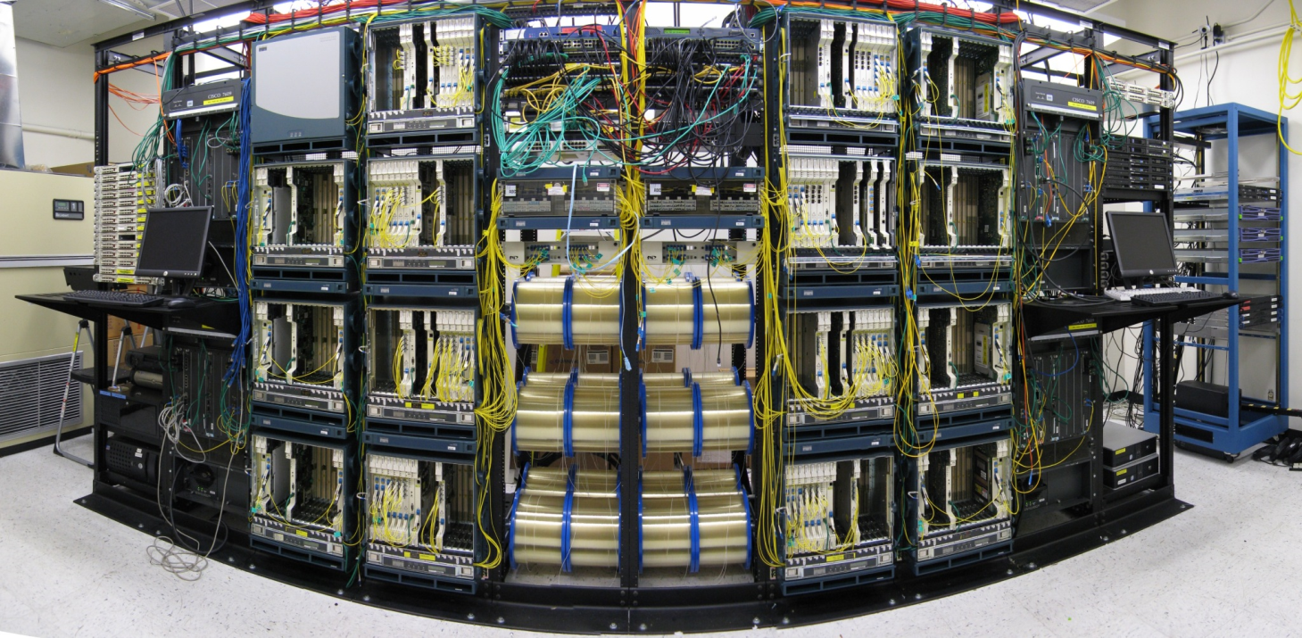
















rsrg
NetLab
prof steven low
Lee Center
SISL
Caltech FAST Project
control & optimization of networks
2000
2001
2002
2003
2004
2005
2006
2007
theory
experiment
Lee Center
FAST TCP theory
IPAM Wkp
WAN-in-Lab Testbed
testbed
deployment
SC02 Demo
Collaborators: Profs Doyle (Caltech), Newman (Caltech), Paganini (Uruguay), Tang (Cornell), Andrew (Swinburne), Chiang (Princeton);
CACR, CERN, Internet2, SLAC, Fermi Lab, StarLight, Cisco, Level(3)
theory
testbed
experiment
deployment
Internet: largest distributed nonlinear feedback control system
WAN-in-Lab : one-of-a-kind wind- tunnel in academic networking, with 2,400km of fiber, optical switches, routers, servers, accelerators
Scientists have used FastTCP to break world records on data transfer between 2002 – 2006
FAST is commercialized by FastSoft; it accelerates world’s 2nd largest CDN and Fortune 100 companies
Reverse engineering: TCP is real-time distributed algorithm over Internet to maximize utility
TCP
FastTCP
eq 2
eq 3
SC 2004
Internet
eq 1
Internet2 LSR
SuperComputing BC
FAST in a box
Forward engineering: Invention of FastTCP based on control theory & convex optimization
with FAST
without FAST

Slide 3

rsrg
NetLab
prof steven low
Lee Center
SISL
Caltech FAST Project
2000
2001
2002
2003
2004
2005
2006
2007
2012
2014
Lee Center
FAST TCP theory
IPAM Wkp
WAN-in-Lab Testbed
SC02 Demo
accelerating largest social networks, studios,
and other Fortune 100 companies
“FAST TCP is accelerating >1TB
of internet traffic every second !”

Slide 4
Vision (20+ yrs)
Global energy demand will continue to grow
Traditional supply is unsustainable
There is more renewable energy than the world ever needs
Someone will figure out how to capture and store it
There will be connected intelligence everywhere
Cost of computing, storage, communication and manufacturing will continue to drop
Power system will transform into the largest and most complex Internet of Things
Generation, transmission, distribution, consumption, storage

Slide 5
Mission
To develop technologies that will enable and guide the historic transformation of our power system
Generation, transmission, distribution, consumption, storage
Devices, systems, theory, algorithms
Control, optimization, stochastics, data, economics

Slide 6







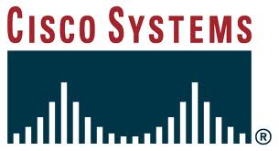
Outline
Overview & challenges
Optimal power flow
Frequency regulation
Applications

Slide 7
Watershed moment
Power network will undergo similar architectural
transformation that phone network went through
in the last two decades
Deregulation
started
IoT
Tesla: multi-phase AC
1888
Both started as natural monopolies
Both provided a single commodity
Both grew rapidly through two WWs
1980-90s
1876
1980-90s
Bell: telephone
Deregulation
started
1969:
DARPAnet
Convergence
to Internet

Slide 8
Watershed moment
Industries will be destroyed & created
AT&T, MCI, McCaw Cellular, Qualcom
Google, Facebook, Twitter, Amazon, eBay, Netflix
Infrastructure will be reshaped
Centralized intelligence, vertically optimized
Distributed intelligence, layered architecture
What will drive power network transformation ?

Slide 9
Four drivers
Proliferation of renewables
Electrification of transportation
challenges
Advances in power electronics
Deployment of sensing, control, comm
enablers

Slide 10
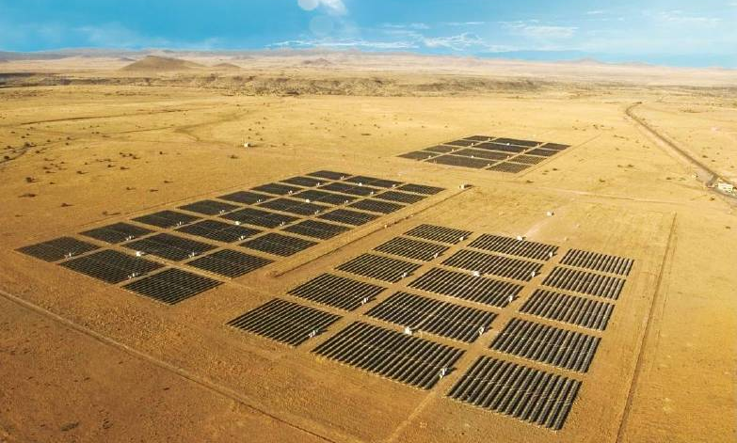
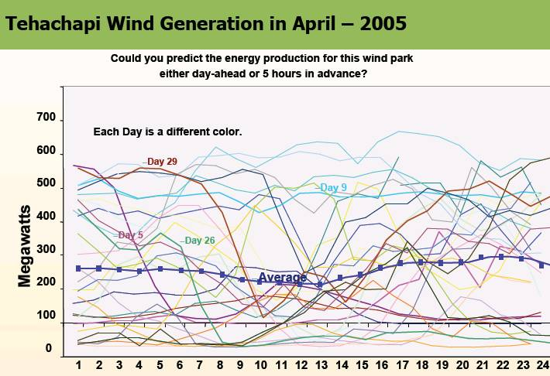
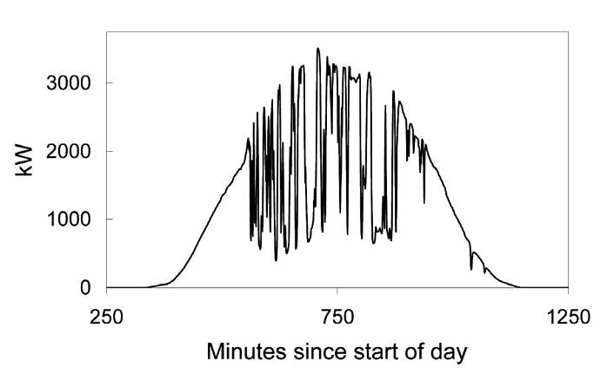
Uncertainty
High Levels of Wind and Solar PV Will Present an Operating Challenge!
Source: Rosa Yang, EPRI

Slide 11
Voltage violations are quite frequent
Source: Leon Roose, University of Hawaii
Development & demo of smart grid inverters for high-penetration PV applications

Slide 12
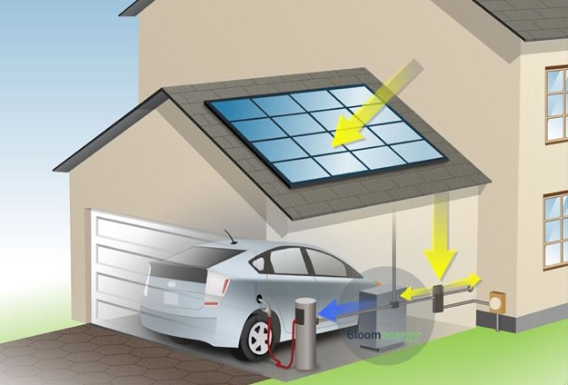
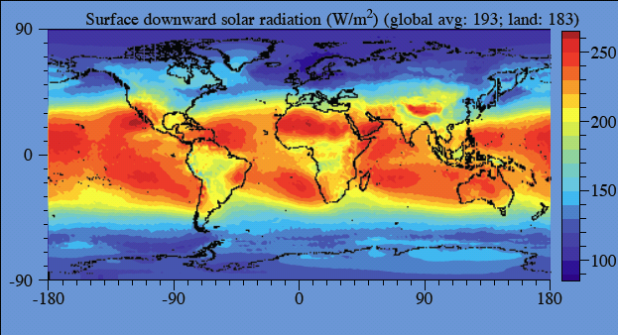

Solar power over land:
> 20x world energy demand
network of
billions of active distributed energy resources (DERs)
DER: PV, wind tb, EV, storage, smart appliances

Slide 13
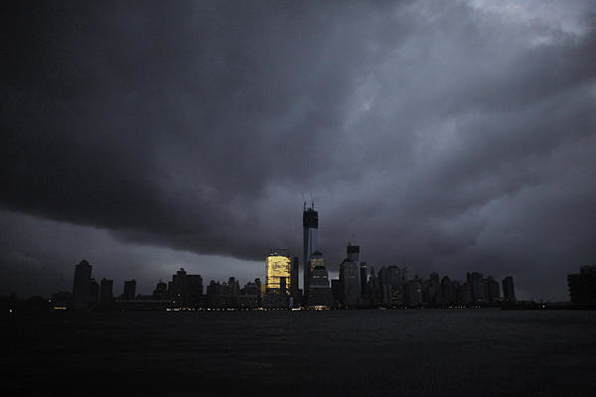
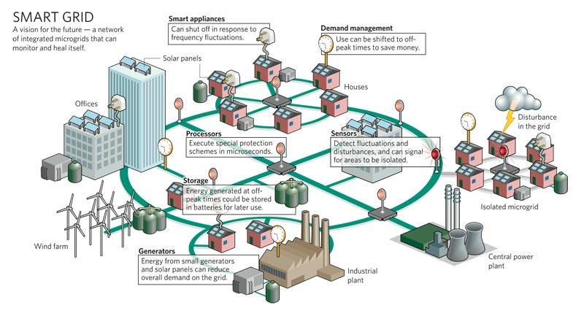
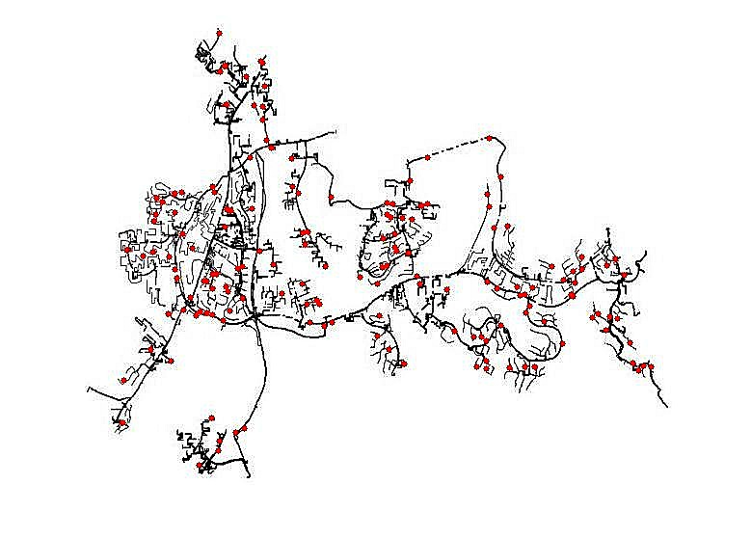
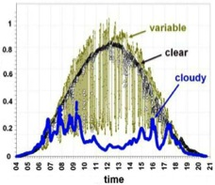
Risk: active DERs introduce rapid random
fluctuations in supply, demand, power quality
increasing risk of blackouts
Opportunity: active DERs enables realtime
dynamic network-wide feedback control,
improving robustness, security, efficiency
Caltech research: distributed control of networked DERs
Foundational theory, practical algorithms, concrete
applications
Integrate engineering and economics
Active collaboration with industry

Slide 14
Active DERs: implications
Current control paradigm works well today
Centralized, open-loop, human-in-loop, worst-case preventive
Low uncertainty, few active assets to control
Schedule supplies to match loads
Future needs
Closing the loop, e.g. real-time DR, volt/var
Fast computation to cope with rapid, random, large fluctuations in supply, demand, voltage, freq
Simple algorithms to scale to large networks of active DER
Market mechanisms to incentivize

Slide 15
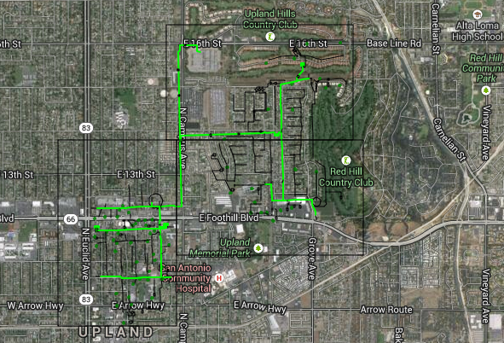
Need for distributed control
Example: Southern California Edison
4-5 million customers
SCE Rossi feeder circuit
#houses: 1,407; #commercial/industrial: 131
#transformers: 422
#lines: 2,064 (multiphase, inc. transfomers)
peak load: 3 – 6 MW
#optimization variables: 50,000
SCE has 4,500 feeders
~100M variables
United States
131M customers, 300K miles of transmission & distr lines, 3,100 utilities

Slide 16
Key challenges
Nonconvexity
Convex relaxations
Large scale
Distributed algorithms
Uncertainty
Risk-limiting approach
Multiple timescales
Decomposition
Ian Hiskens, Michigan

Slide 17
Our research
economics
and
regulations
DER
adoption
storage
Infrastructure inv.
EV charging
demand
response
market
power
freq control
control
and
optimization
volt/var
optimal power flow (OPF)
sec
min
hour
day
year

Slide 18
Outline
Overview & challenges
Optimal power flow (OPF)
problem formulation
semidefinite relaxations
exact relaxation
Frequency regulation
Applications

Slide 19
Optimal power flow (OPF)
OPF is solved routinely for
network control & optimization decisions
market operations & pricing
at timescales of mins, hours, days, …
Non-convex and hard to solve
Huge literature since Carpentier 1962
Common practice: DC power flow (LP)
Also: Newton-Raphson, interior point, …

Slide 20
Optimal power flow (OPF)
OPF underlies many applications
Unit commitment, economic dispatch
State estimation
Contingency analysis
Feeder reconfiguration, topology control
Placement and sizing of capacitors, storage
Volt/var control in distribution systems
Demand response, load control
Electric vehicle charging
Market power analysis
…

Slide 21
Nonconvexity of OPF
Semidefinite relaxations of power flows
Physical systems are nonconvex …
… but have hidden convexity that should be exploited
Convexity is important for OPF
Foundation of LMP, critical for efficient market theory
Required to guarantee global optimality
Required for real-time computation at scale

Slide 23
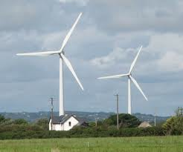

Bus injection model
i
j
k
admittance matrix:
graph G: undirected
Y specifies topology of G and
impedances z on lines

Slide 24
Bus injection model
In terms of :
Power flow problem:
Given find
isolated solutions

Slide 25
OPF: bus injection model
gen cost,
power loss
power flow equation

Slide 26
OPF: bus injection model
gen cost,
power loss
power flow equation

Slide 27
OPF: bus injection model
nonconvex QCQP
(quad constrained quad program)

Slide 28
Other features
Security constraint OPF
Solve for operating points after each single contingency (N-1 security)
N sets of variables and constraints, one for each contingency
Unit commitment
Discrete variables
Stochastic OPF
Chance constraints Pr(bad event) <
Other constraints
Line flow, line loss, stability limit, …
… OPF in practice is a lot harder

Slide 29
Semidefinite relaxations of OPF
relaxation | model | first proposed | first analyzed
SOCP | BIM | Jabr 2006 TPS
SDP | BIM | Bai et al 2008 EPES | Lavaei, Low 2012 TPS Bose et al 2011, 2015 Zhang, Tse 2011, 2013 Sojoudi, Lavaei 2012
Chordal | BIM | Bai, Wei 2011 EPES Jabr 2012 TPS | Molzahn et al 2013 TPS Bose et al 2014 TAC
SOCP | BFM | Farivar et al 2011 SGC Farivar, Low 2013 TPS | Farivar et al 2011 SGC Farivar, Low 2013 TPS Gan et al 2012, 2014
Chordal unbalanced | BFM | Gan, Low 2014 PSCC | Gan, Low 2014 PSCC
Tutorial with extensive refs:
Low. Convex relaxation of OPF (I, II), IEEE Trans Control of Network Systems, 2014

Slide 30
Basic idea
Approach
Three equivalent characterizations of V
Each suggests a lift and relaxation
What is the relation among different relaxations ?
When will a relaxation be exact ?

Slide 31
Feasible set & SDP
quadratic in V
linear in W
Equivalent problem:
convex in W
except this constraint

Slide 32
Equivalent feasible sets
QCQP: n variables
SDP: n² vars !

Slide 33
Equivalent feasible sets

Slide 34
Equivalent feasible sets

Slide 35
Equivalent feasible sets

Slide 36
Equivalent feasible sets

Slide 37
Cycle condition
local
cycle
cond
global

Slide 38
Equivalent feasible sets
Theorem:
Bose, Low, Chandy Allerton 2012
Bose, Low, Teeraratkul, Hassibi TAC2014

Slide 39
Equivalent feasible sets
Theorem:
Given there is
unique completion and unique
Can minimize cost over any of these sets, but …

Slide 40
Equivalent feasible sets

Slide 41
Relaxations
Theorem
Radial G :
Mesh G :
Bose, Low, Chandy Allerton 2012
Bose, Low, Teeraratkul, Hassibi TAC2014

Slide 42
Relaxations
Theorem
Radial G :
Mesh G :
For radial networks: always solve SOCP !

Slide 43
Recap: semidef relaxations
G

Slide 44
Examples
Real Power
Reactive Power
SOCP Y
SDP Y
power flow
solution X
Relaxation is exact if X and Y have same Pareto front
SOCP is faster but coarser than SDP
Bose, Low, Teeraratkul, Hassibi TAC 2014

Slide 45
Without PS: SDP vs SOCP
SDP
SOCP
SDP
SOCP
SOCP
inexact
SDP not
scalable

Slide 46
Examples
SDP/ch
SOCP
SDP
chordal
SOCP
SOCP
inexact
SDP not
scalable

Slide 47
SOCP more efficient than SDP
Relaxations are exact in all cases
IEEE networks: IEEE 13, 34, 37, 123 buses (0% DG)
SCE networks 47 buses (57% PV), 56 buses (130% PV)
Single phase; SOCP using BFM
Matlab 7.9.0.529 (64-bit) with CVX 1.21 on Mac OS X 10.7.5 with 2.66GHz Intel Core 2 Due CPU and 4GB 1067MHz DDR3 memory

Slide 48
OPF-socp
OPF-ch
OPF-sdp
OPF-socp
2x2 rank-1
rank-1
equality
Y, mesh
Y
Y, mesh
Y
radial
Y
radial
cycle
condition
cycle
condition
Recover V*
Y
Y
OPF solution

Slide 49
OPF-socp
OPF-ch
OPF-sdp
OPF-socp
2x2 rank-1
rank-1
equality
Y, mesh
Y
Y, mesh
Y
radial
Y
radial
cycle
condition
cycle
condition
Recover V*
Y
Y
OPF solution

Slide 50
OPF-socp
OPF-ch
OPF-sdp
OPF-socp
2x2 rank-1
rank-1
equality
Y, mesh
Y
Y, mesh
Y
radial
Y
radial
cycle
condition
cycle
condition
Recover V*
Y
Y
open problem
open problem
OPF solution

Slide 51
What is the relation among relaxations ?
When will a relaxation be exact ?

Slide 52
Summary of sufficient conds
necessary condition for exact relaxation:
Louca, Seiler, Bitar 2014

Slide 53
1. QCQP over tree
QCQP
graph of QCQP
QCQP over tree

Slide 54
1. Linear separability
QCQP
Key condition
Theorem
SOCP relaxation is exact for
QCQP over tree
Bose et al 2012, 2014
Sojoudi, Lavaei 2013

Slide 55
Implication on OPF
Not both lower & upper bounds on real & reactive powers at both ends
of a line can be finite

Slide 56
2. Voltage upper bounds
geometric insight

Slide 57
2. Voltage upper bounds
when there is no voltage constraint
feasible set : 2 intersection pts
relaxation: line segment
exact relaxation: c is optimal
… as long as cost increasing in

Slide 58
2. Voltage upper bounds
voltage lower bound (upper bound on l) does not affect relaxation

Slide 59
2. Voltage upper bounds
OPF:
SOCP:
Key conditions:
Jacobian condition
voltages if network were lossless
if upward current were reduced
then all subsequent powers dec
Theorem
SOCP relaxation is exact for
radial networks
Gan, Li, Topcu, Low TAC2014

Slide 60
2. Voltage upper bounds
OPF:
SOCP:
Key conditions:
Jacobian condition
satisfied with large margin in
IEEE circuits and SCE circuits
Theorem
SOCP relaxation is exact for
radial networks
Gan, Li, Topcu, Low TAC2014

Slide 61
OPF: extensions
Kim, Baldick 1997
Dall’Anese et al 2012
Lam et al 2012
Kraning et al 2013
Devane, Lestas 2013
Sun et al 2013
Li et al 2013
Peng, Low 2014
applications
Phan 2012
Gopalakrishnan 2012
Louca et al 2013
Hijazi et al 2013
B&B,
rank min,
QC relaxation,
distributed
OPF
semidefinite relaxations
multiphase
unbalanced
exactness
moment/SoS,
based
relaxation
Dall’Anese et al 2012
Gan, Low 2014
ext refs in Low
TCNS 2014
Louca et al 2014
Molzahn, Hiskens 2014
Josz et al 2014
Ghaddar et al 2014

Slide 62
Outline
Overview & challenges
Optimal power flow (OPF)
Frequency regulation
load-side participation
algorithm design and stability
Applications

Slide 63
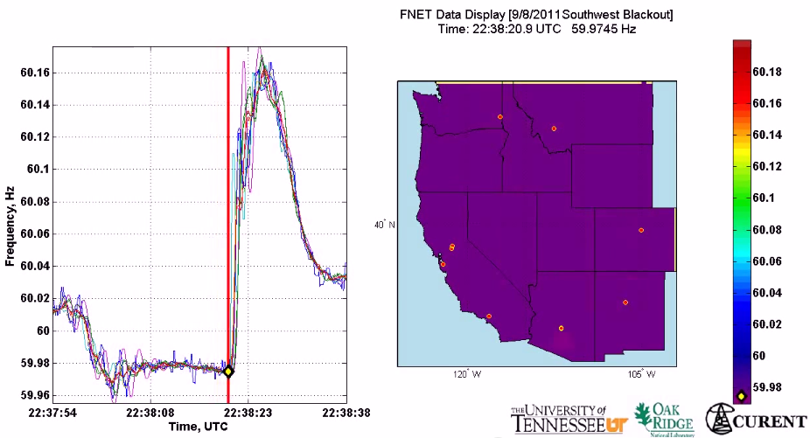
Motivation
All buses synchronized to same nominal frequency (US: 60 Hz; Europe: 50 Hz)
Supply-demand imbalance ➔ frequency fluctuation
(1 min)
2011 Southwest blackout

Slide 64
Motivation
Imagine when we have 33%+ renewable generation …
(10 min)
(1 min)

Slide 65
Frequency control
Traditionally done on generator-side
primary: rebalance power, resynchronize freq
secondary: restore nominal freq & inter-area flows
tertiary (EC): maximize economic efficiency
secondary freq control
economic
dispatch
primary
freq control
sec
min
5 min
60 min

Slide 66
Why load-side participation
Ubiquitous continuous load-side control can supplement generator-side control
faster (no/low inertia)
no extra waste or emission
more reliable (large #)
better localize disturbances
reducing generator-side control capacity
secondary freq control
economic
dispatch
primary
freq control
sec
min
5 min
60 min

Slide 67
What is the potential
Residential load accounts
for ~1/3 of peak demand
61% residential appliances
are Grid Friendly
US:
operating reserve: 13% of peak
total GFA capacity: 18%
Lu & Hammerstrom (2006), PNNL

Slide 68
Can household Grid Friendly
appliances follow its own PV
production?
60,000 AC
avg demand ~ 140 MW
wind var: +- 40MW
temp var: 0.15 degC
Dynamically adjust
thermostat setpoint
Callaway, Hiskens (2011)
Callaway (2009)

Slide 69
How
How to design load-side frequency control ?
How does it interact with generator-side control ?

Slide 70
Literature: load-side control
Original idea
Schweppe et al 1979, 1980
Small scale trials around the world
D.Hammerstrom et al 2007, UK Market Transform Programme 2008
Numerical studies
Trudnowski et al 2006, Lu and Hammerstrom 2006, Short et al 2007, Donnelly et al 2010, Brooks et al 2010, Callaway and I. A. Hiskens, 2011, Molina-Garcia et al 2011
Analytical studies
Zhao et al (2012/2014), Mallada et al (2014), Zhao and Low (2014)
Simpson-Porco et al 2013, You and Chen 2014, Zhang and Papachristodoulou (2014), Zhao, et al (2014)

Slide 71
Our work
Zhao et al 2014 TAC
Mallada et al 2014 Allerton
Zhao et al 2015 CISS
basic design
approach:
primary
linear
secondary
nonlinear
w/ gen control
secondary
nonlinear
Zhao, Low 2014 CDC

Slide 72
Network model
branch power
generation
loads:
controllable + uncontrollable
i : region/control area/balancing authority

Slide 73
Dynamic model
generator bus: real power injection

Slide 74
Dynamic model
generator buses:

Slide 75
Dynamic model
load bus: controllable load
how to design controller d_{i}(t) ?
Proposed approach
formalize control goals as OLC
derive distributed control as primal-dual alg

Slide 76
Load-side controller design
Control goals
Rebalance power
Stabilize frequency
Restore nominal frequency
Restore scheduled inter-area flows
Zhao, Topcu, Li, Low
TAC 2014
Mallada, Zhao, Low
Allerton, 2014

Slide 77
Optimal load control (OLC)
demand = supply
key idea: “virtual flows”
in steady state: virtual = real flows

Slide 78
Optimal load control (OLC)
demand = supply
restore nominal freq
in steady state: virtual = real flows

Slide 79
Optimal load control (OLC)
demand = supply
restore nominal freq
restore inter-area flow
respect line limit
in steady state: virtual = real flows

Slide 80
Distributed load control
load control:
local frequency deviation
measured locally at load
virtual frequency
computed locally based on neighborhood comm
network dynamics + active load control
= first-order primal-dual algorithm for OLC

Slide 81
Distributed control architecture
physical
cyber

Slide 82
Load-side control works
Theorem
Every closed-loop equilibrium solves OLC and its dual
Suppose
Any closed-loop equilibrium is (locally) asymptotically stable provided

Slide 83
Simulations
Dynamic simulation of IEEE 39-bus system
Power System Toolbox (RPI)
Detailed generation model
Exciter model, power system
stabilizer model
Nonzero resistance lines

Slide 84
Primary control
Can replacing gen-side control
with load-side control
Load-side participation improves
transient and steady state
PSS 39-bus, same control capacity
Primary frqueny control
PSS 14-bus, same control capacity
Secondary frequency control

Slide 85
Recap
Forward-engineering design facilitates
explicit control goals
distributed algorithms
stability analysis
Load-side frequency regulation
essential as renewable replaces thermal gen
improves generator-side control

Slide 86
Outline
Overview
Optimal power flow (OPF)
Frequency regulation
problem formulation
semidefinite relaxations
exact relaxation
Applications

Slide 87
OPF research
2012
2013
2014
2015
2016
Theoretical foundation
semidefinite relaxations of OPF
Algorithm design
unbalanced OPF, distributed OPF
Implementation & T2M
IoT gateway, testbed, field test

Slide 88
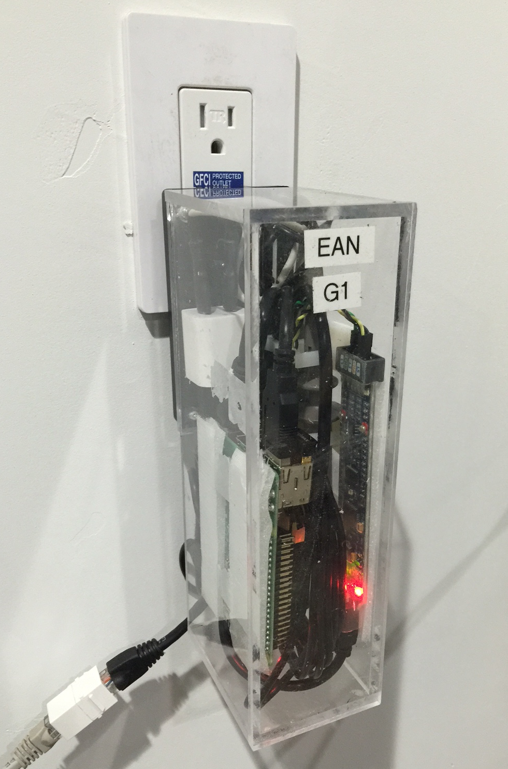
IoT gateway prototype
compute
OPF
freq control
communicate
IoT gateway
WiFi/4G
cloud
sense
control
power
voltage
frequency
EV charger
thermostat
inverters
George Lee

Slide 89
Testbed

Slide 90
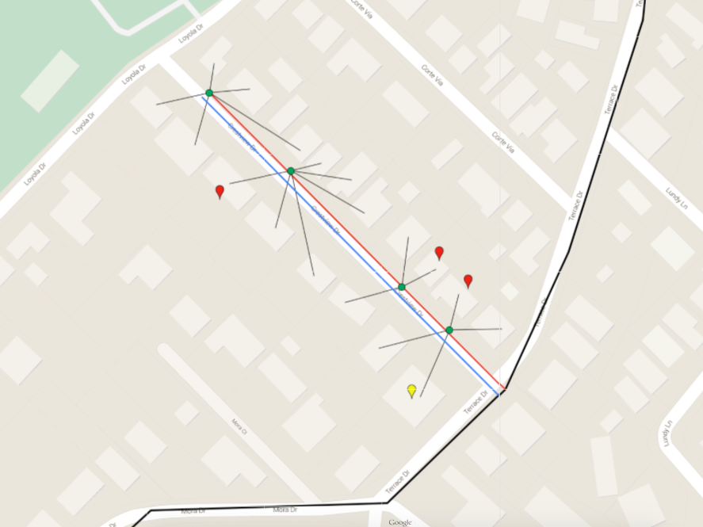
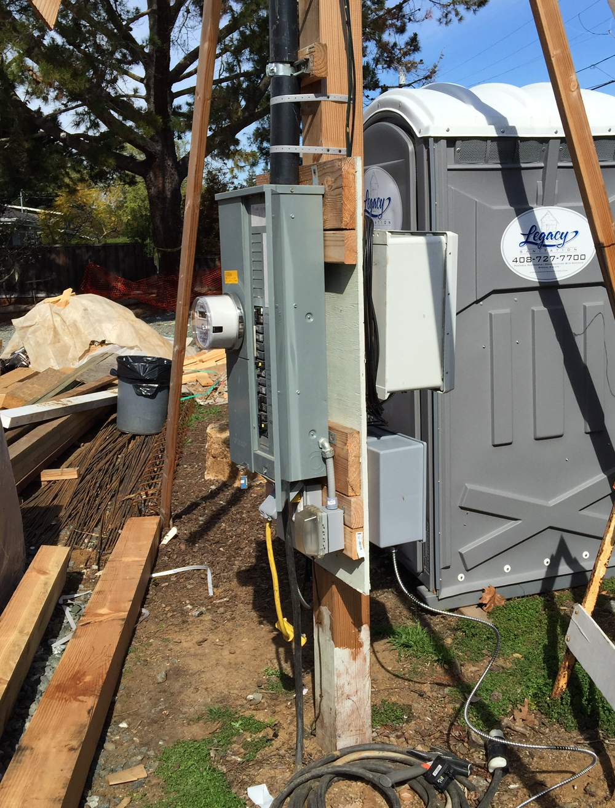
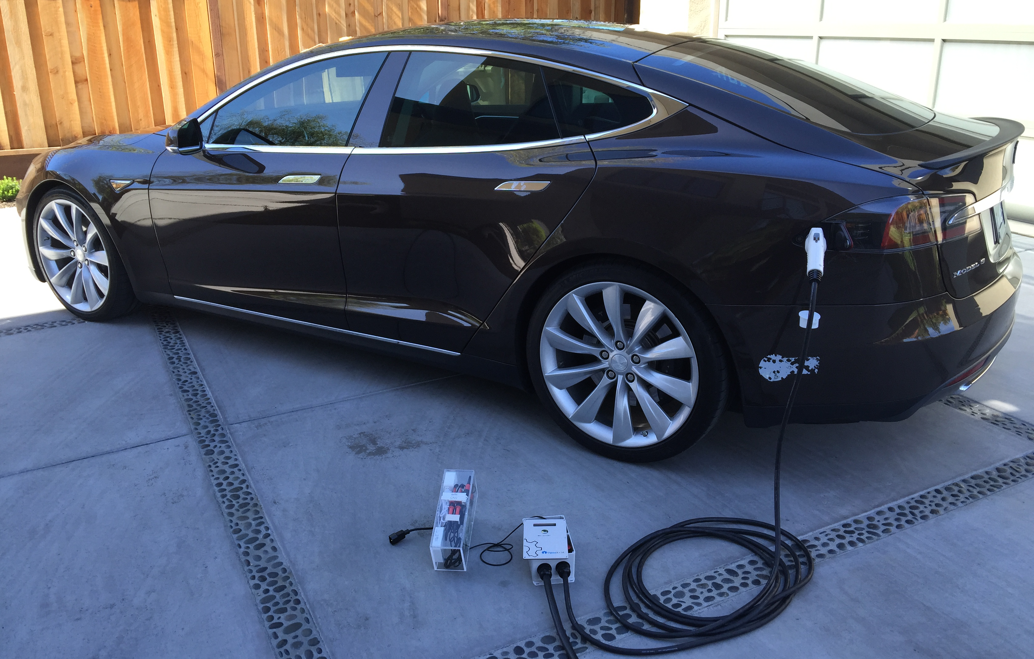
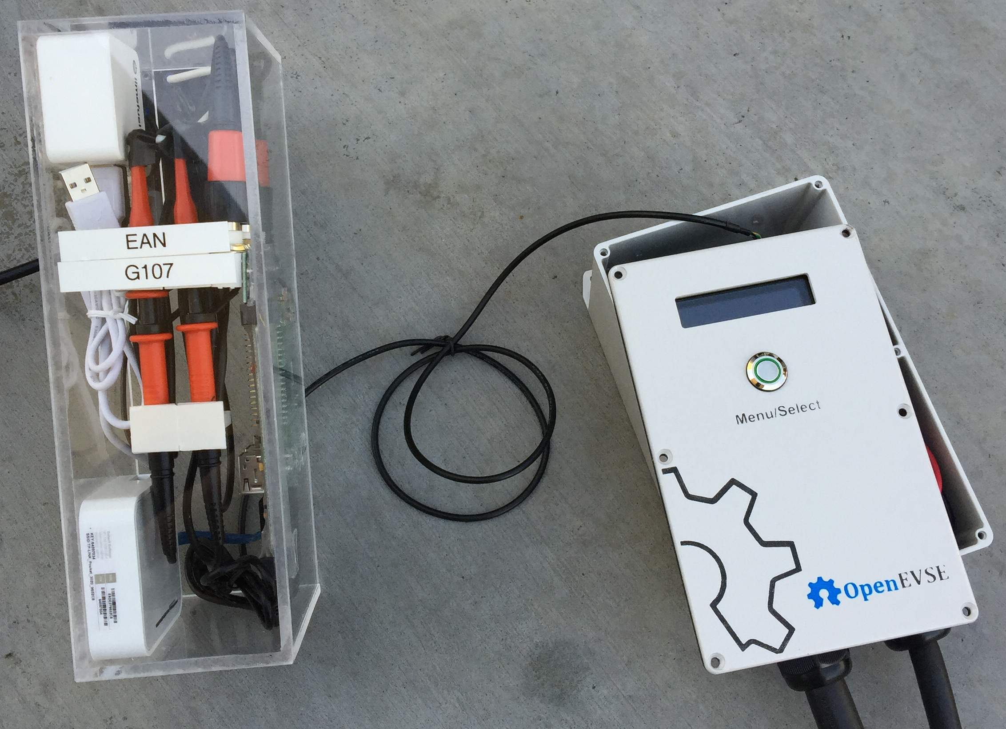
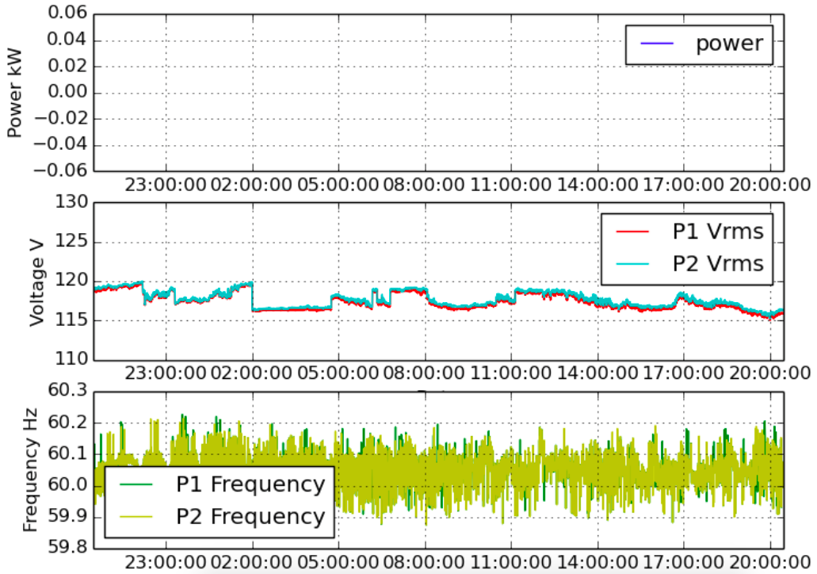
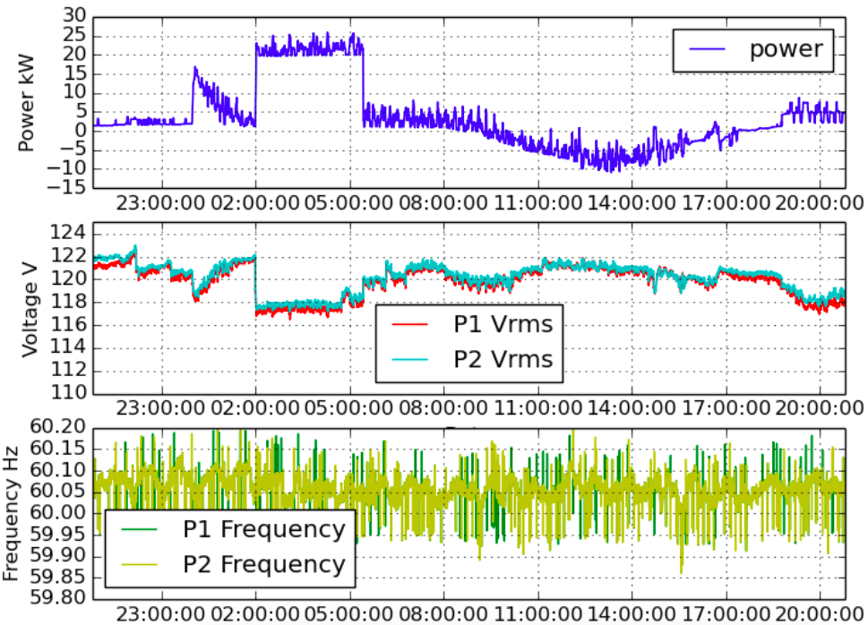
Field test
EV charging
app
HVAC control
compute
George Lee
comm
sense
control

Slide 91
Tech-to-market
IoT has been growing
at unprecedented rate
Energy is the largest
application for IoT

Slide 92
Tech-to-market
SG IT software is
already a multi-B
market

Slide 93
Risk: active DERs introduce rapid random
fluctuations in supply, demand, power quality
increasing risk of blackouts
Opportunity: active DERs enables realtime
dynamic network-wide feedback control,
improving robustness, security, efficiency
Caltech research: distributed control of networked DERs
Foundational theory, practical algorithms, concrete
applications
Integrate engineering and economics
Active collaboration with industry

